Slide 1
Catia Capstone Project
DUSTIN Gross,Dustan Paul

Slide 2
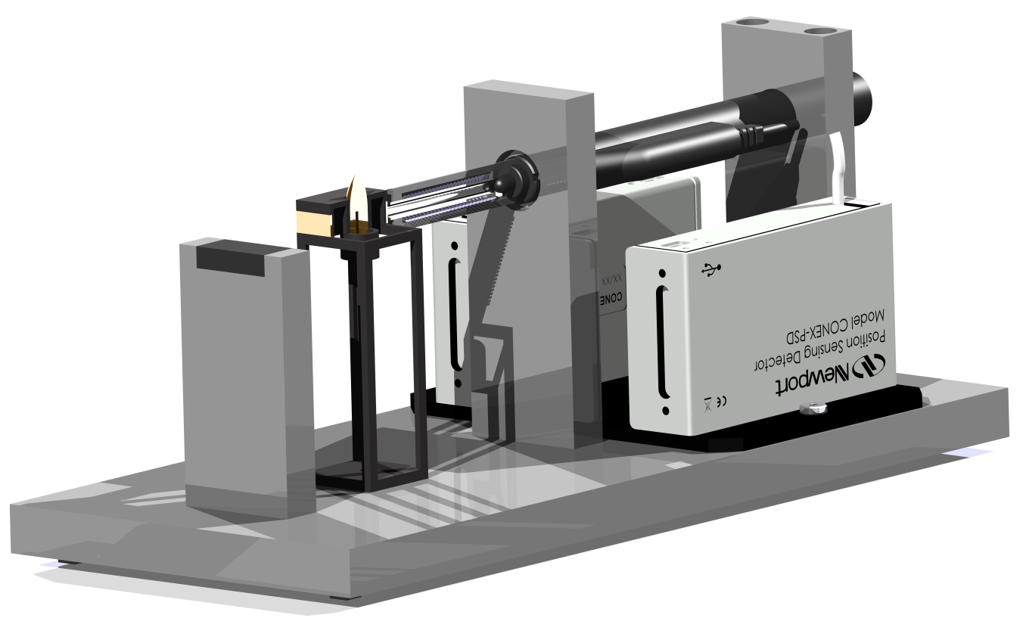

Slide 3
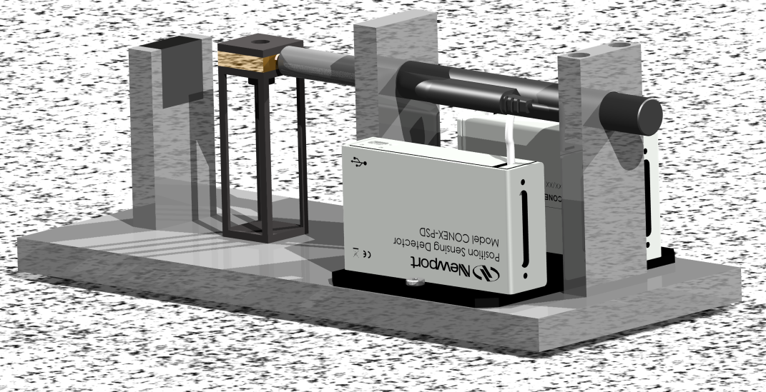

Slide 4
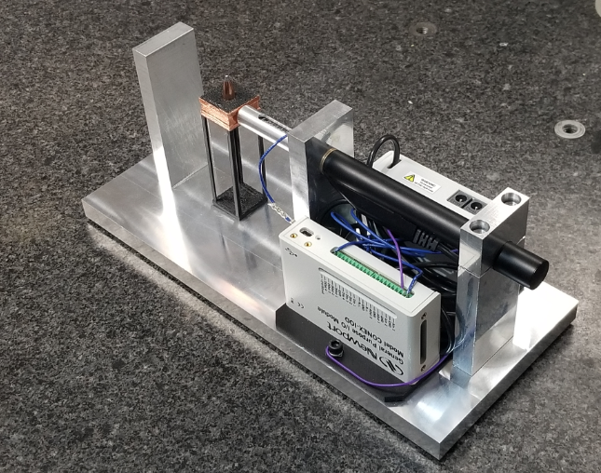

Slide 5
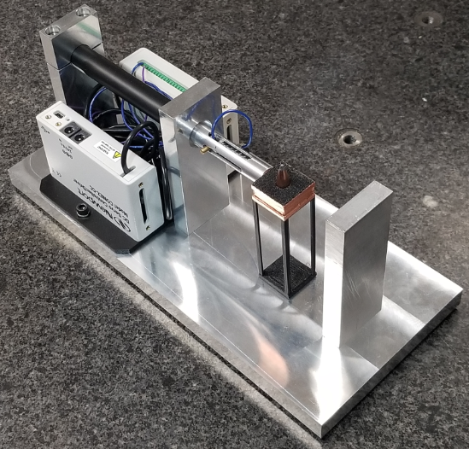

Slide 6
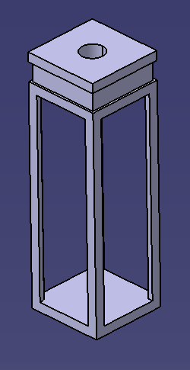
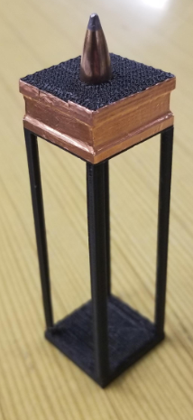
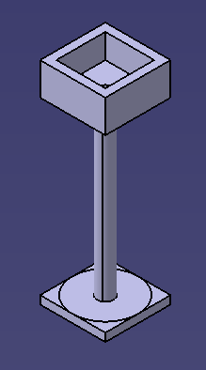
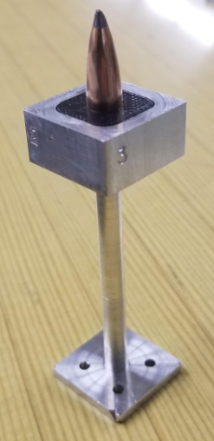

Slide 7
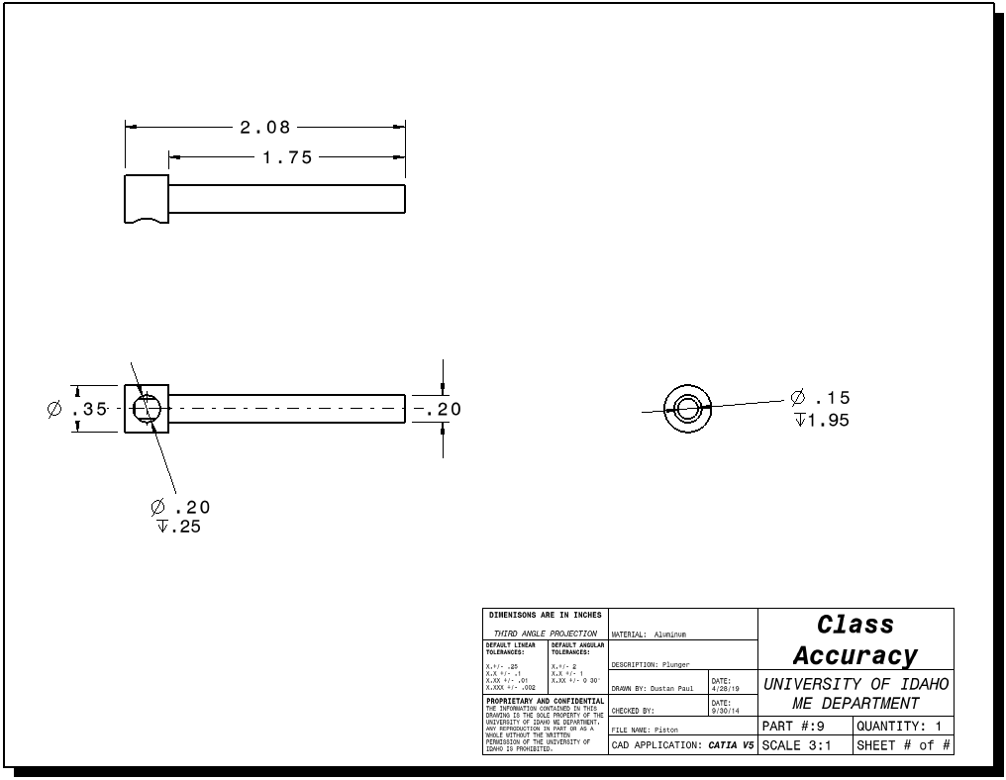

Slide 8
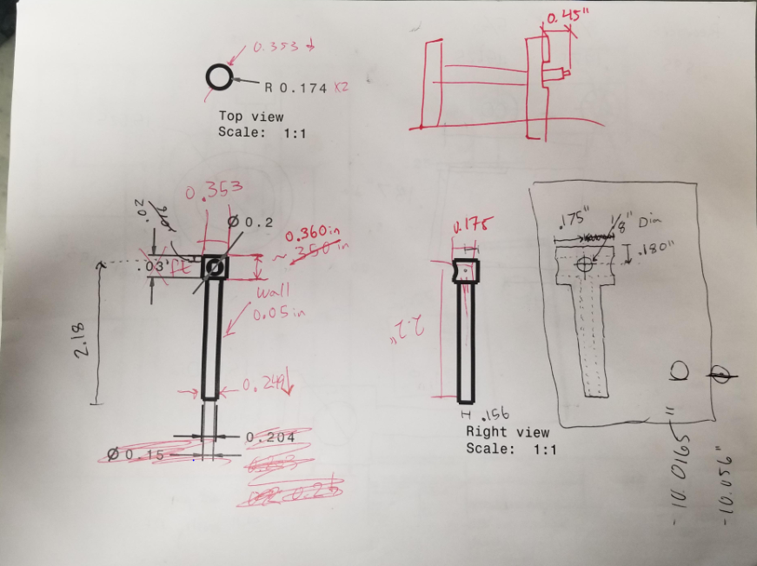

Slide 9
LESSONS LEARNED:
Update working documents
Global variables are your friend
Assemblies create big picture understanding
Understand shop restrictions
Create realistic models

Slide 10
QUESTIONS?

